Slide 1





JavaScript Tools
Tools for Writing / Editing / Debugging JavaScript Code
SoftUni Team
Technical Trainers
Software University
http://softuni.bg

Slide 2

Table of Contents
JavaScript Development Tools
Visual Studio 2013
Sublime Text with Plugins
WebStorm
Debugging tools
Google Chrome / Opera Developer Tools
Firefox Firebug
Internet Explorer F12
Utilities

Slide 3

JavaScript Tools
Know Your Tools!

Slide 4
JavaScript Tools
JavaScript is an interpreted language
Usually run by the browser
May be run on the server-side
Coding in JavaScript needs just a text editor
Yet, there are many tools that simplify JavaScript coding
Editors, debuggers, code analyzers, etc…
Good JS IDEs support features like:
Integrated debugging, autocomplete, syntax checking

Slide 5


JavaScript Development Tools
Coding JavaScript Made Easy!

Slide 6
JavaScript Development Tools
All a developer needs for coding JavaScript is a text editor
Notepad/Notepad++ will do the trick
Yet, JavaScript is one of the popular guys now
Many, many tools for coding JavaScript
Sublime Text + Plugins
Visual Studio + Node.js Tools
Adobe Brackets, Cloud9, WebStorm, Vim
JavaScript Development Tools for Eclipse

Slide 7

Visual Studio + Node.js Tools

Slide 8
Visual Studio
Visual Studio is the main dev tool for creating .NET apps
ASP.NET, WPF, Silverlight, SharePoint, Windows 8, etc…
VS 2012/2013 are ready-to-use for JavaScript coding
They have pretty good intelli-sense, code highlighting, etc…
There are paid and free versions
Visual Studio Web Developer / Express / Premium / Ultimate
Use Node.js Tools for VS
To enable server-side execution and debugging

Slide 9

Node.js Tools for Visual Studio
Visual Studio has Node.js Tools Plugin
http://nodejstools.codeplex.com
Runs Node.js into Visual Studio
Powerful, well integrated debugger
Has no DOM, runs out of the browser

Slide 10
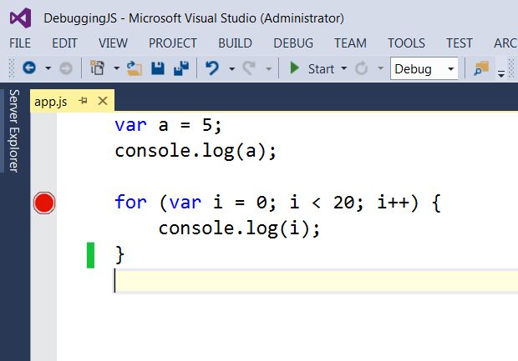
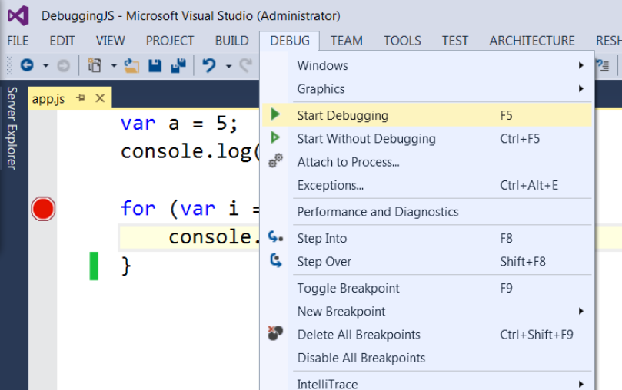
Debugging Node.js in Visual Studio
Just like C# debugger
Add breakpoint and start debugging with [F5]

Slide 11
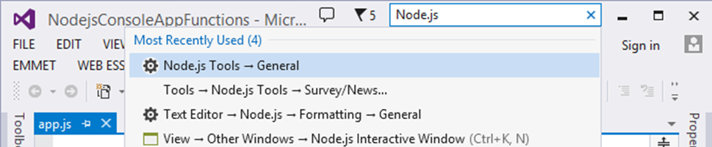
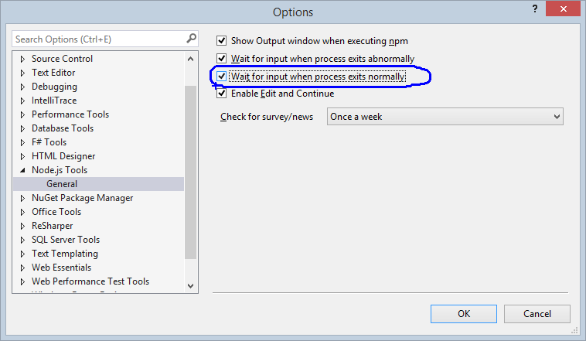
VS + Node.js Tools: Lost Console Output
Problem: the console is lost just after my JS program finishes
I can't see the program output
How to keep it?

Slide 12
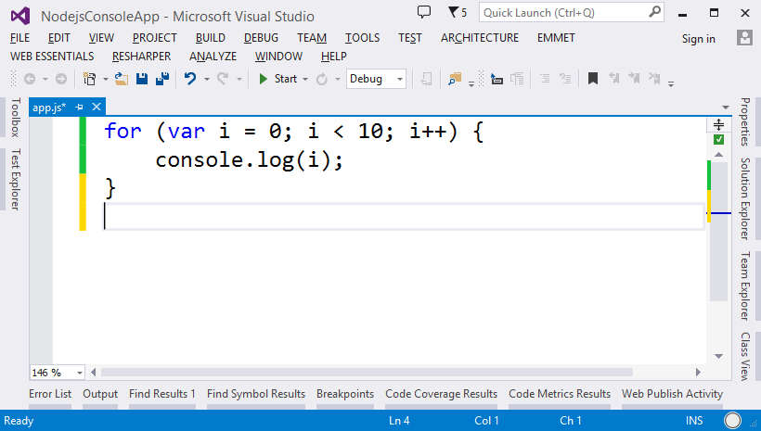
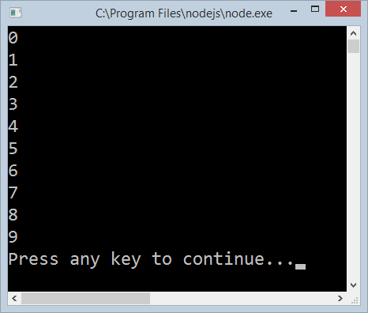
Visual Studio + Node.js Tools
Live Demo

Slide 13
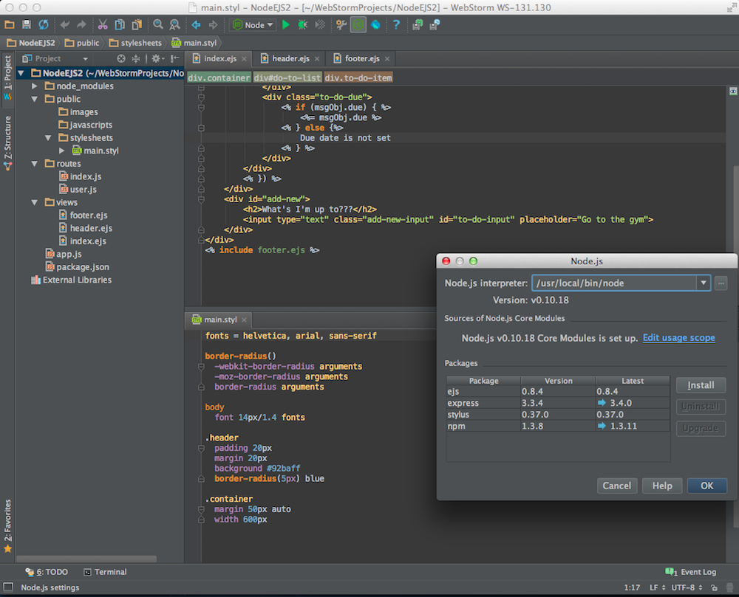
WebStorm
A Very Smart JavaScript IDE

Slide 14
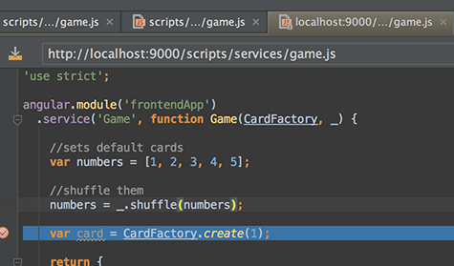
WebStorm
JavaScript IDE suitable for both client-side JS and server-side (Node.js) development
Build JavaScript code
Debug JavaScript code
Code intelli-sense for:
SASS/LESS/Stylus CSS preprocessors
CoffeeScript/TypeScript JavaScript preprocessors
Emmet coding
Paid product (free 1 year license for SoftUni student)

Slide 15
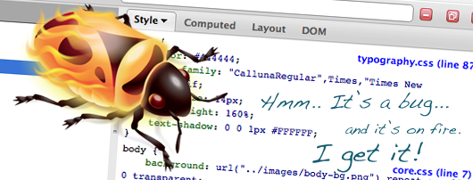
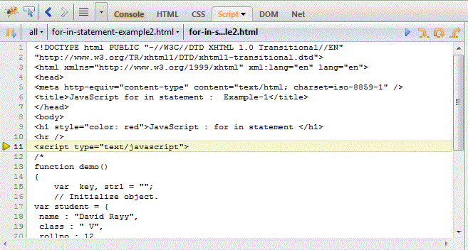
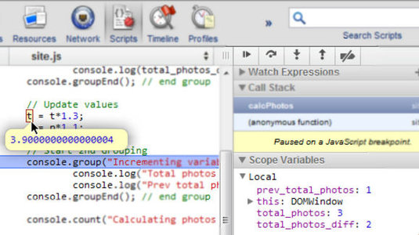
Debugging JavaScript
Using All the Tools

Slide 16
Debugging JavaScript
Modern browsers have JavaScript console where errors in scripts are reported
Errors may differ across browsers
Several tools to debug JavaScript
Microsoft Script Editor
Add-on for Internet Explorer
Supports breakpoints, watches
JavaScript statement debugger; opens the script editor

Slide 17
Firebug
Firebug
Firefox add-on for debugging JavaScript, CSS, HTML
Supports breakpoints, watches, JavaScript console editor
Very useful for CSS and HTML too
You can edit all the document real-time: CSS, HTML, etc
Shows how CSS rules apply to element
Shows Ajax requests and responses
Firebug is written mostly in JavaScript

Slide 18
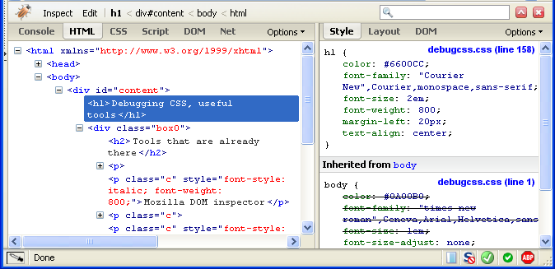
Firebug (2)

Slide 19
Debugging JavaScript
Sadly, no intelligent way of debugging client-side JavaScript
The only way to debug JavaScript is through the browser
Fortunately all browsers have their own debugging tool / plugin that makes it easier
Firefox has Firebug – http://getfirebug.com
Chrome and Opera have Web Developer Tools
Internet Explorer has [F12]

Slide 20
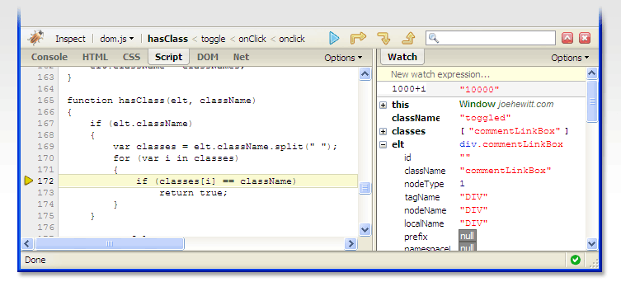
Debugging JavaScript
Live Demo

Slide 21
JavaScript Utilities
Tools for JS Developers

Slide 22
JavaScript Utilities
JavaScript code quality tools
http://www.jshint.com
http://www.jslint.com
HTML, CSS and JavaScript playgrounds
http://jsbin.com
http://liveweave.com
JavaScript performance tester
http://jsperf.com

Slide 23
JavaScript Utilities
Live Demo

Slide 24


Summary
JS Developer Tools
WebStorm
Visual Studio + Node.js Tools
JS Debuggers
The [F12] Tools
JS Utilities
JSHint, JSLint, JSBin, …
JS Basics

Slide 25







JavaScript Tools
https://softuni.bg/courses/javascript-basics

Slide 26
License
This course (slides, examples, demos, videos, homework, etc.) is licensed under the "Creative Commons Attribution-NonCommercial-ShareAlike 4.0 International" license
Attribution: this work may contain portions from
“JavaScript Basics" course by Telerik Academy under CC-BY-NC-SA license

Slide 27





Free Trainings @ Software University
Software University Foundation – softuni.org
Software University – High-Quality Education, Profession and Job for Software Developers
softuni.bg
Software University @ Facebook
facebook.com/SoftwareUniversity
Software University @ YouTube
youtube.com/SoftwareUniversity
Software University Forums – forum.softuni.bg

